Slide 1

Preparing for the Workplace
Applications, Resumes, & Interviews
Senior Advisory

Slide 2

Where to find jobs:
If you have a specific company in mind, check their website.
Top sites:
Indeed.com
CareerBuilder.com
Glassdoor.com
LinkedIn.com

Slide 3
Before you apply:
According to a 2018 CareerBuilder survey, 70% of employers use social media to screen candidates during the hiring process.
Notes:
Check your social media before you apply for a job. Make sure you do not have anything offensive or inappropriate. It may be best to make sure your profiles are set to private.

Slide 4
Types of Applications
Online - Most companies have moved to an online platform for applicants to apply for their open positions. This is convenient for the employer and the applicant. It also saves your information in case you apply for other jobs with the organization in the future.
In-Person - Some companies request that you pick up and drop off their application in person. If so, make sure you are dressed appropriately when doing both. If you are applying in person, ask for a digital copy of the application so you can type instead of handwriting.
Paper - If you must complete a paper application, write very neatly and in pen. Ask for two copies of the application so you can fill out a new one if you make any mistakes.
Notes:
Most organizations have their own portal where you will login to fill out an application. In some cases, you will be asked to come to the organization to fill out the application.

Slide 5

Filling out Applications
Most companies require you to fill out an application, even if you are submitting a cover letter and resume.
  Do not type on the application “See Resume”
Be prepared
  Make sure you know the correct names, dates, places, and other information you will need.
  Review your employment history. You can use your resume to transfer information to your application.
Always follow the instructions
  The slightest error could could knock your application out of the running before an employer even gets the chance to look at it.
Notes:
Employers will have very specific instructions on their applications. Read everything very carefully.

Slide 6
Filling out Applications (continued)
Make sure you check the application deadline and allow yourself enough time to get the application and all other documents submitted on time.
Review before you submit.
  Thoroughly read the instructions for applying for employment before you click the submit button (or hand in your application). Make sure every field is field in.
Notify your references.
  Let your references know that you’ve listed them on your application so that they can expect an email or a call.
Be prepared to take a test. Some companies test applications for employment in order to determine whether the candidate is a good match for the job.
It is illegal to ask certain questions on a job application. These include: age/date of birth, gender, race, religion, and country of origin.

Slide 7
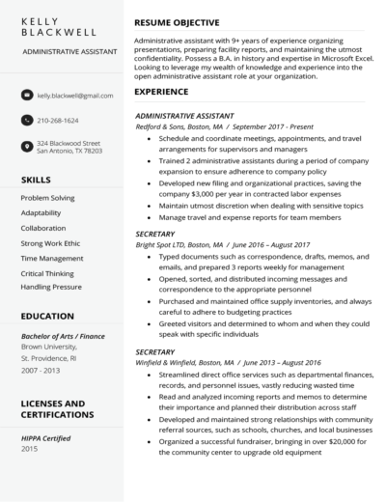
Resume
Make sure your resume is updated with all of your current information
If you do not have a resume, you can use a template to create one
Make sure you are 100% honest!

Slide 8

Getting the Call for an Interview
If you have applied for a job, make sure you are available to answer your phone as often as possible.
If you miss the call for an interview, call back as soon as possible.
When you are on the phone with your potential employer, make sure you are in a quiet place with no distractions.
Be as flexible as possible when scheduling your interview. For example, if they give you a specific date for an interview, do your best to schedule the interview on that day.

Slide 9

Types of Interviews
In-person - One-on-one
  This is an interview usually with the supervisor or manager.
In-person - Panel
  This is an interview with 3+ people usually including human resources, a supervisor, a manager, and another employee in the department
Phone/Skype/FaceTime
  If you have applied for a job that is out-of-town, you may have a phone/Skype/FaceTime interview first.
Second Interview
  Depending on the job, you may have 2-3 rounds of interviews. If you do well on your first interview, you will be invited to a second interview. In your second interview, you will be asked more detailed questions about yourself, your qualifications, and your ability to perform for the company.

Slide 10

Top 10 Interview Mistakes
Dressing inappropriately
Arriving late
Bringing a drink with you - No Dutch Bros, Starbucks, or Dunkin!
Using your phone during the interview
Not knowing anything about the company
Fuzzy resume facts
Not paying attention
Talking too much
Not being prepared to answer questions
Badmouthing past employers

Slide 11

Preparing for the Interview
Know the position
  Most of the time, the company will post a job description with the job posting. Make sure you print or download the job description so you have a full understanding of the position.
Know yourself
  Be ready to answer questions honestly and stay true to who you are.
  Know the information on your resume
Know the organization
  Research the organization before your interview so you can incorporate what you know into your interview questions.
Prepare questions
  At the end of most interviews, you will be asked if you have any questions. You should have at least 1 or 2 questions prepared. Examples include: What is the next step in the hiring process?, What would my day-to-day routine look like if I got the job?, What is the key to succeeding in this role?, How does this position fit in with the rest of the organization?

Slide 12
Preparing for the Interview (cont’d)
Practice out loud - Either by yourself or with someone, practice answering interview questions out loud. This part is very important. What you think you may say in your head might not come out like you planned.
Dress Attire
  Men
    If you have a suit, you should wear it.
    If you do not own a suit, you should wear dress pants, a dress shirt, a tie, and dress shoes.
    Whatever you wear should comfortable and fit you well so that you look and act your best.
    Avoid loud colors and flashy ties
    Clothing should be neat, clean, and pressed
    Wear deodorant but do not wear cologne or aftershave. You don’t want to smell overpowering.
    Make sure you have fresh breath.
    Your hair should be neat, clean, and conservative.
Notes:
Before you say a single word to the interviewer, you have already made an impression based on how you are dressed. You can never be overdressed for an interview but you can definitely be underdressed.

Slide 13
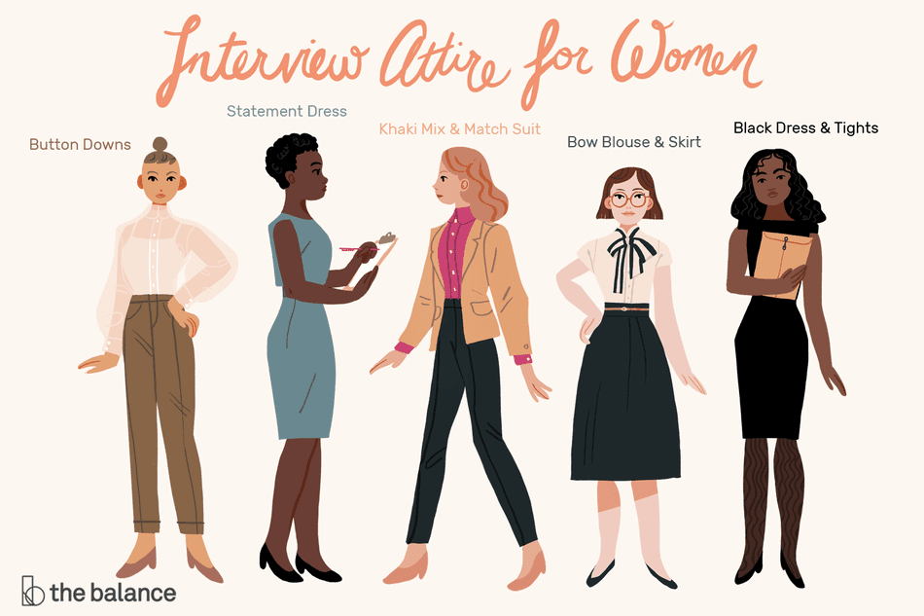
Preparing for the Interview (cont’d)
  Women
    You should wear a blazer with dress pants or a skirt
    If you do not own a blazer, wear nice blouse or button up shirt with dress pants or skirt
    Whatever you wear should comfortable and fit you well so that you look and act your best
    Avoid anything tight, bright, short, or sheer.
    Clothing should be neat, clean, and pressed
    Make-up and nail polish should be understated and flattering; neutral tones are best
    Keep your jewelry and hair accessories to minimum
    Shoes should be conservative and fairly low-heeled
    Wear deodorant but do not wear perfume.
    Make sure you have fresh breath
    Your hair should be neat, clean, and conservatively styled. You may want to wear your hair up or in a low ponytail.
Notes:
Before you say a single word to the interviewer, you have already made an impression based on how you are dressed. You can never be overdressed for an interview but you can definitely be underdressed. You may not dress like this in the position you are hired for but you are more likely to be taken seriously when you present yourself in a professional manner.

Slide 14


Slide 15

The Interview
Arrive 10-15 minutes early
Turn off and put away your cell phone
Be courteous to everyone you meet
Be yourself and be honest
Address the interviewer by Mr./Ms. and their last name, unless they tell you otherwise
Meet the interviewer(s) with a firm handshake, a friendly smile, and polite greeting
Do not sit until offered a seat, or ask where they would like you to sit
Be brief (1-2 minutes to answer each question)
Be positive, speak slowly, and pause before answering
Be confident, poised, and show interest and enthusiasm
Maintain good eye contact
Be observant
Close strong - sell yourself

Slide 16

After the Interview
Ask about follow-up procedures and collect a business card
Shake everyone’s hand again
Thank the interviewer(s) for the opportunity and tell them you look forward to hearing from them
Send any requested materials promptly
Respond to emails and voicemails promptly
Send a thank you email to each person you met (within 24 hours)
  Thank you very much for the opportunity to interview for the position of [job title] yesterday. I enjoyed speaking with you, meeting other members of the staff, and the opportunity to learn more about this position. I am very interested in this position and the opportunity to join your team.

Slide 17


